Slide 1
Osteoarthritis of the Hip, Knee, and Ankle
CAMBRIDGESHIRE Community Services – DynamicHealth
How is Osteoarthritis managed?
© DynamicHealth part of Cambridgeshire Community Service NHS Trust 2018 All rights reserved
Notes:
Video number 2 considers the many management strategies that will be available to you in order to best control and improve your symptoms

Slide 2
Weight Management
Being overweight increases the strain on your joints.
Increases your risk of developing osteoarthritis.
Over time makes it more likely your arthritis will get worse.
When we walk, run and go up and down stairs the force put through your knees can be up to six times your body weight.
Losing weight can make a big difference to the strain on
your joints.
© DynamicHealth part of Cambridgeshire Community Service NHS Trust 2018 All rights reserved
Notes:
There is a great deal of evidence to suggest being overweight increases the strain on your joints. Research suggest that being overweight or obese not only increases your risk of developing osteoarthritis but may also make it more likely that your arthritis will get worse over time.
Because of the way joints work, the force put through your knees and ankles when you walk, run and go up and down stairs can be up to five or six times your body weight. Losing even a small amount of weight can make a big difference to the strain on your joints.
No special diet has shown to help specifically with osteoarthritis, but if you need to lose some weight you should follow a balanced diet combined with regular exercises; if there are other medical reasons why you struggle to lose weight such as diabetes or underactive thyroid we recommend that you seek further advice and guidance from your GP.

Slide 3
Pain relief
Simple painkillers such as paracetamol (an analgesic) may help.
Ice/heat.
Transcutaneous electrical nerve stimulation (TENS)
© DynamicHealth part of Cambridgeshire Community Service NHS Trust 2018 All rights reserved
Notes:
Painkillers can often control pain and stiffness, although they won’t help the arthritis itself and wont repair the changes to the joint. Simple painkillers such as paracetamol are usually a good choice to try first.
Applying warmth to a painful joint often relieves pain and stiffness or osteoarthritis. A hot water bottle or wheat pack are very effective. This can be helpful if you have a flare-up of pain when you’ve done a bit too much. An ice pack can also help to reduce swelling.
Transcutaneous electrical nerve stimulation (TENS) – It is a small electronic device that sends pulses to the nerve endings via pads placed on your skin. It produces a tingling sensation and modifies pain messages transmitted to your brain. TENS machines are usually available from your local pharmacy.
If you have tried the above and you continue to have severe pain, we advise you to seek further guidance for your GP as they may recommend stronger painkillers or non-steroidal anti-inflammatories.

Slide 4
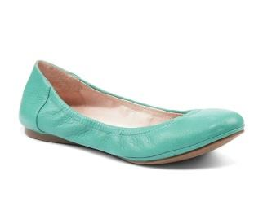
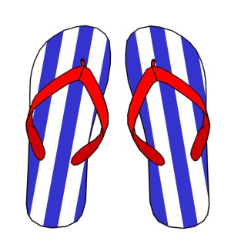
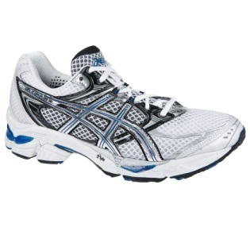
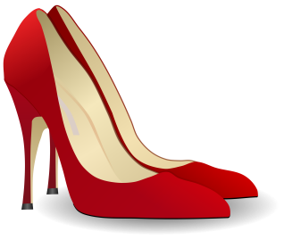
Footwear
Do wear:
Low-healed shoes.
Soft, thick soles
Don’t wear:
High heels
Flip flops
Ballet pumps
© DynamicHealth part of Cambridgeshire Community Service NHS Trust 2018 All rights reserved
Notes:
Wear low-heeled shoes with a soft, thick sole. Thicker soles will act as shock absorbers. We advise against heels as they will alter the angle of your hip, knee and big toe joints and put additional strain on them.
Although this is the general rule, we are not saying only wear sensible shoes, its more if you are doing increased physical activity.

Slide 5
Reducing the Strain on Your joints
Pace your activities throughout the day.
Use a walking stick to reduce the weight and stress on your joints.
Use a handrail for support when going up and down the stairs.
Don’t stay in one position for too long.
Think about modifying your home, car or workplace to reduce unnecessary strain.
Learn to relax your muscles.
Sleep.
© DynamicHealth part of Cambridgeshire Community Service NHS Trust 2018 All rights reserved
Notes:
Apart from managing your weight, exercising and reviewing you footwear, there are a number of other ways you can reduce the strain on your joints.
Pace your activities through the day – don’t tackle all the physical jobs at once. i.e. housework, gardening, DIY. Breaks up the harder jobs into chunks and something more gentle in between. Keep performing your usual activities, but rest when if becomes painful.
Using a walking stick to reduce the weight and stress on a painful joint.
Use the handrail for support when going up and down stairs.
Don’t stay in one position for too long.
Think about modifying your home, car or workplace to reduce unnecessary strain. An occupational therapist can advise you on special equipment that will make your tasks easier.
Learn to relax your muscles and get the tension out of your body. This can be achieved with the use of guided imagery or progressive muscle relaxation.
Sleep – If pain is a problem at night, heat may help. Try a hot bath before going to bed, or use a hot water bottle or wheat bag. Taking pain relief before going to beb can also ease night-time pain so you can get to sleep more easily. You might also like to try placing a pillow between your knee to help ease your pain.

Slide 6
Aerobic Exercise
Cardiovascular Exercise
Any exercise that increases your pulse rate and makes you a bit short of breath.
Helps you sleep better.
Is good for your health and well-being.
© DynamicHealth part of Cambridgeshire Community Service NHS Trust 2018 All rights reserved
Notes:
Aerobic exercise:
Is any exercise that increases your pulse rate and makes you a bit short of breath. Regular aerobic exercise should help you sleep better, is good for your general health and well-being and reduces pain by stimulating the release of pain relieving hormones called endorphins.
Swimming can be very good for osteoarthritis. Because water supports the weight of your body, therefore you won’t be putting a lot of strain on your joints as you exercise. Ultimately, you should perform an exercise that you enjoy doing.

Slide 7
Strengthening Exercise
Improves the strength and conditioning of your muscles.
Helps to stabilise and protect the joint.
Ultimately helps to reduce pain.
© DynamicHealth part of Cambridgeshire Community Service NHS Trust 2018 All rights reserved
Notes:
Strengthening exercises:
These will improve the strength and condition of the muscles that control the affected joint. Osteoarthritis of you knee can weaken you thigh muscles whilst osteoarthritis of your hip can weaken your buttock muscles, so regular exercising of these muscles helps to stabilise and protect the joint. It has also been shown to reduce pain.
Sometime you might need to take pain relief when performing your exercises; if you need to take a pain killer, try taking it approx. 45-minutes before you start doing your exercise. You might be worried that you are doing more damage by masking the pain. You’re not! We ask you to take them to maximise the effects of performing the exercises.
For ankles it is also very important to perform balance exercises to improve the stability of the joint.

Slide 8
Home exercise program
Local muscle strengthening for each muscle group around the hip, knee and ankle.
Perform one exercise from each section and progress as able.
Perform your exercises daily or as is comfortable.
Perform the exercises on both legs where possible.
© DynamicHealth part of Cambridgeshire Community Service NHS Trust 2018 All rights reserved
Notes:
The exercises in the available links are focused on local muscle strengthening, as recommended by the National Institute of Clinical Excellence (NICE) guidelines for osteoarthritis. You may wish to pick one exercise from each section and do these once a day. Please start off at the level that you feel suits you best and progress as able. The lying down exercises can be done on a bed or on the floor and you may use a pillow. The exercises may cause a pulling sensation but should not cause great levels pain. There are also some exercises aimed at joint range of movement and muscle stretching. These should be performed on both legs where possible.
It is important that you find a level of exercise that you can do on both good and bad days. Joints do not wear out with normal usage; in fact the opposite can be true. Too much rest can accelerate the arthritic process. To keep a healthy joint it must be regularly taken through its range of movement, this helps to keep it loose, and lubricated. It’s vital that your muscles are kept strong, this will help protect the joints.

Slide 9
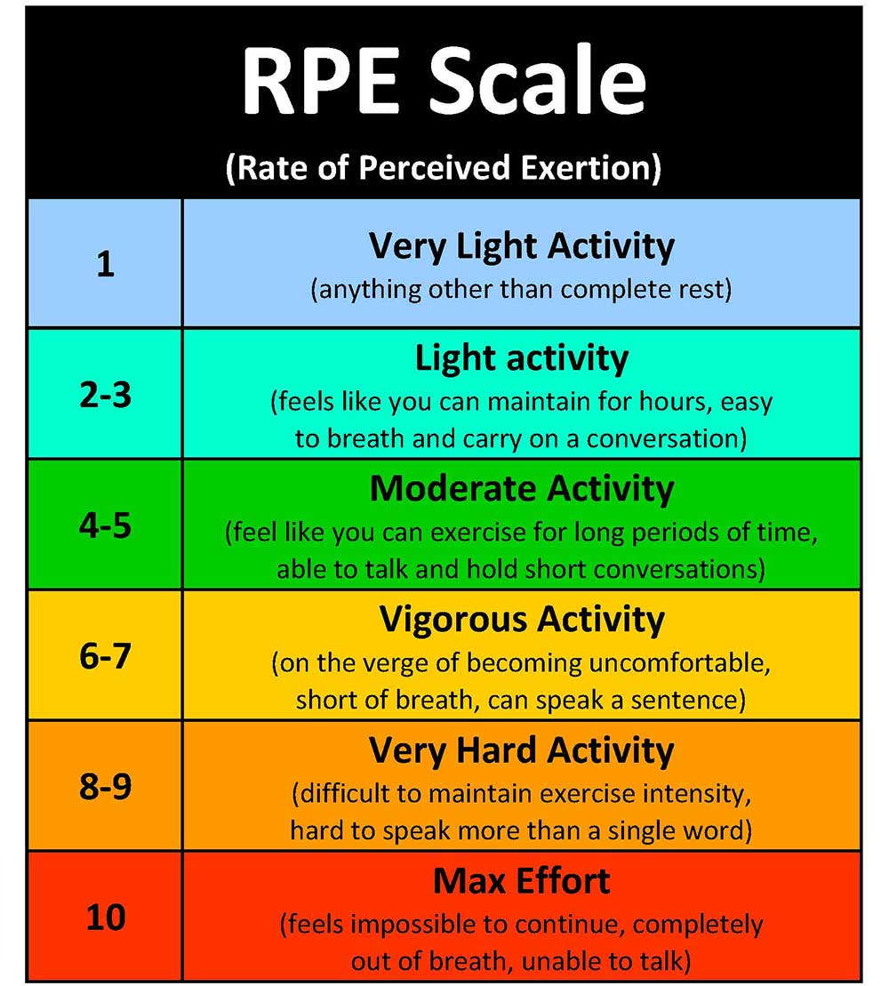
How do I Know if I am working Hard Enough
© DynamicHealth part of Cambridgeshire Community Service NHS Trust 2018 All rights reserved
Notes:
This resource is useful for monitoring your effort and ensuring you are working at an appropriate level. Please see the exercise booklet we have attached for advice on which level you should be working at and how you can achieve this.

Slide 10
TIME TO EXERCISE!!!
© DynamicHealth part of Cambridgeshire Community Service NHS Trust 2018 All rights reserved
Notes:
We hope that you now have all of the tools to control your symptoms and manage your condition in the most efficient way possible. Please take 5 minutes to consider this information before progressing on to video number 3.

